Slide 1
AVIAGE SYSTEMS Big Data & ML Introduction
2018/10/31

Slide 2
Platform
Platform Introduction

Slide 3
Platform Introduction Agenda
Hadoop Platform
ML Tool
Reporting Tool

Slide 4
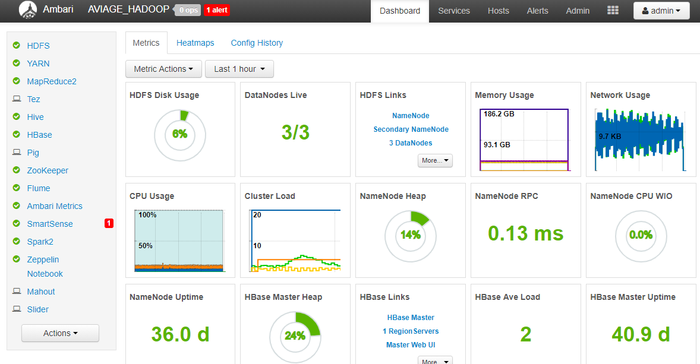
Big Data Platform
Built on Hadoop Hortonworks Distribution
2 Name Nodes + 3 Data Nodes, 16TB Space;
Tesla V100 GPU for High Performance Computing

Slide 5
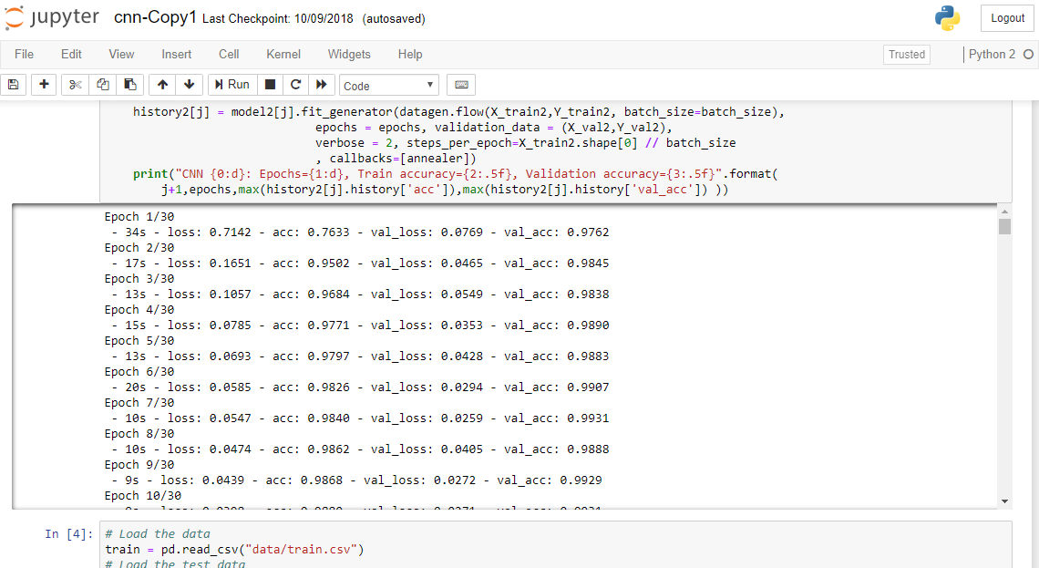
ML Tool
Jupyter Notebook for ML (Python based)

Slide 6
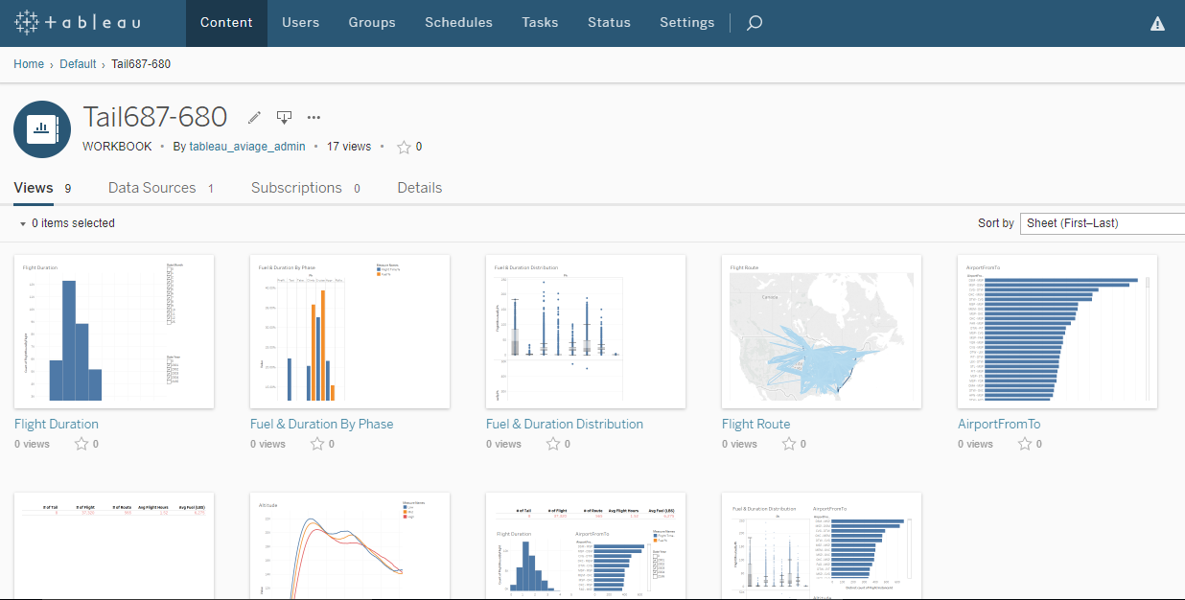
Reporting Tool
Tableau Server + Tableau Client

Slide 7
Case 1
Engine Status Prognostic Prediction

Slide 8
Case1 Agenda
Purpose
Data Source Introduction
Check the Relationship between Sensor_Measures and Remaining_Useful_Life
Training Models
Ensemble Multiple Models

Slide 9
Purpose
To predict the airplane engine “remaining useful life (cycle times)” based on the collected sensor data installed on the engine.
Help to understand the running status of the engine and any abnormal situation
Provide a prognostic prediction to help better schedule the engine maintenance time

Slide 10
Data Source
NASA provide a prognostic data set for analysis
https://ti.arc.nasa.gov/tech/dash/groups/pcoe/prognostic-data-repository/
Data Set: FD001 Train trjectories: 100 Test trajectories: 100 Conditions: ONE (Sea Level) Fault Modes: ONE (HPC Degradation) Data Set: FD002 Train trjectories: 260 Test trajectories: 259 Conditions: SIX Fault Modes: ONE (HPC Degradation)
Data Set: FD003 Train trjectories: 100 Test trajectories: 100 Conditions: ONE (Sea Level) Fault Modes: TWO (HPC Degradation, Fan Degradation) Data Set: FD004 Train trjectories: 248 Test trajectories: 249 Conditions: SIX Fault Modes: TWO (HPC Degradation, Fan Degradation)

Slide 11
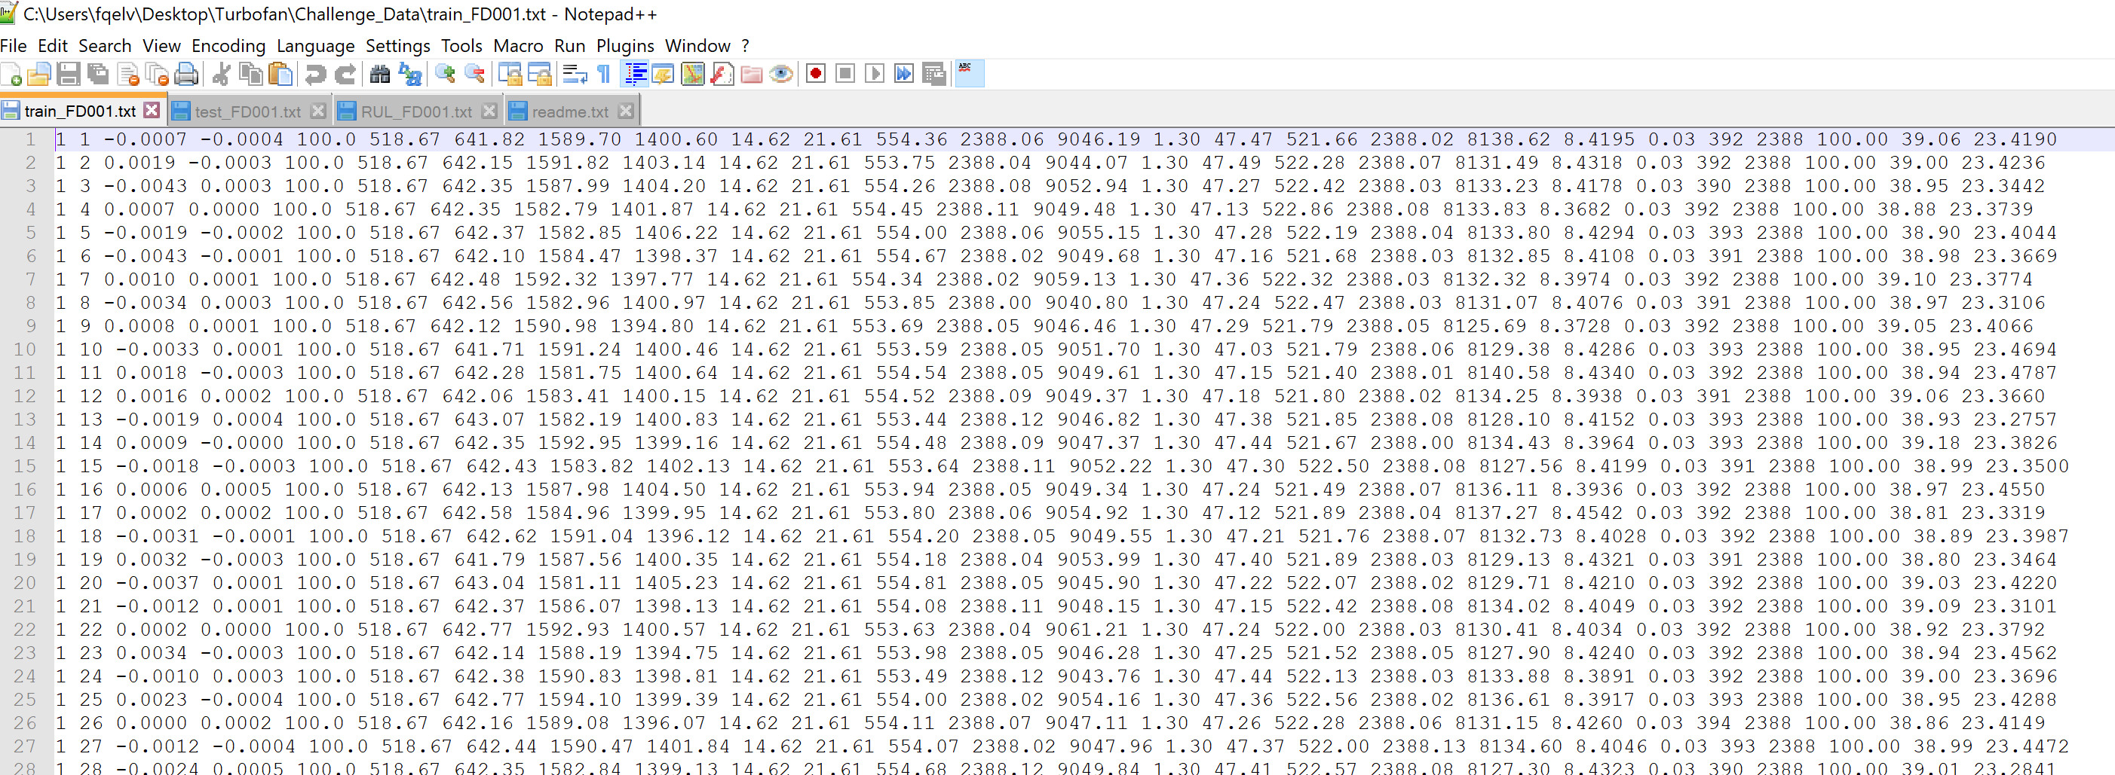
Data Source
The data are provided as a zip-compressed text file with 26 columns of numbers, separated by spaces. Each row is a snapshot of data taken during a single operational cycle, each column is a different variable. The columns correspond to: 1) unit number 2) time, in cycles 3) operational setting 1 4) operational setting 2 5) operational setting 3 6) sensor measurement 1 7) sensor measurement 2 ... 26) sensor measurement 21

Slide 12
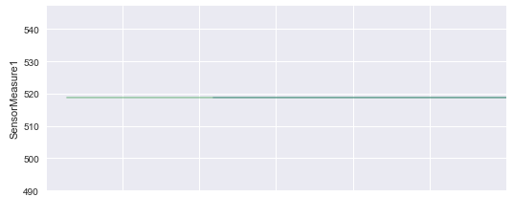
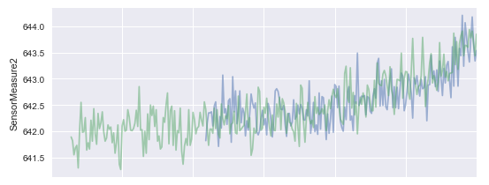
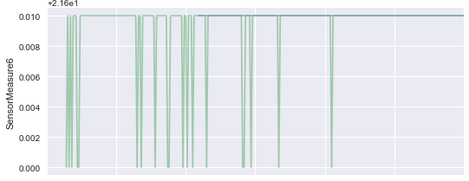
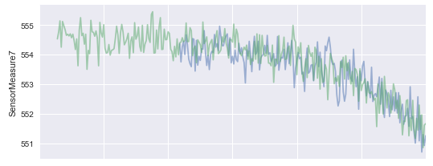
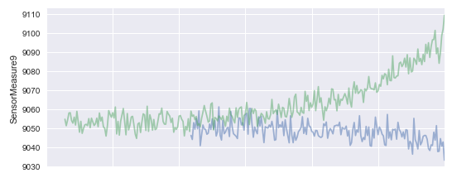
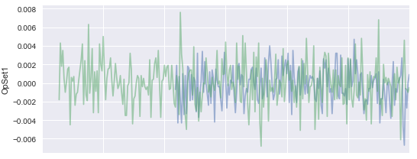
Check the Relationship between Sensor_Measures and Remaining_Useful_Life
This to find our the key measurements

Slide 13
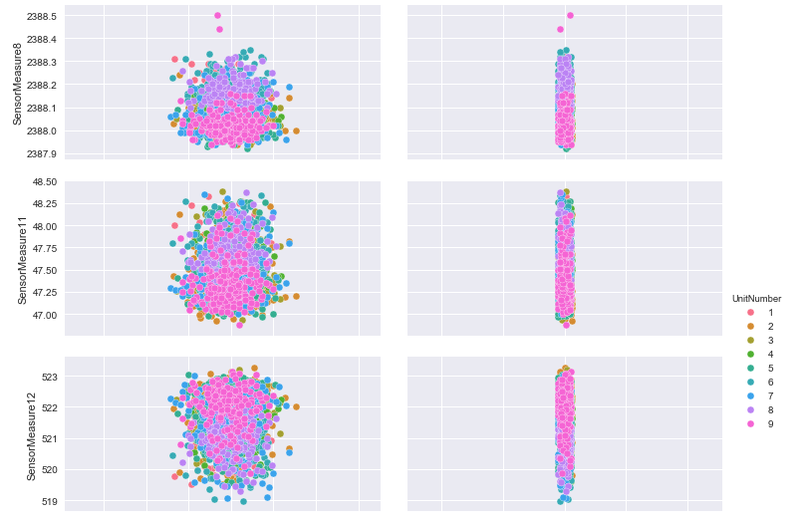
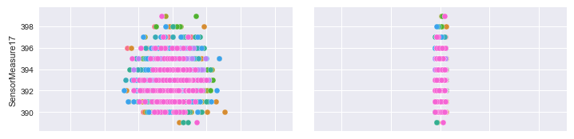
Check the Relationship between Sensor_Measures and Remaining_Useful_Life
Check Data Distribution, Help to understand the data more

Slide 14
Training Models
Random Forest Model
Tree based model, will output measurement importance
Gradient Boosting Model
Training Fast with good accuracy
Recurrent Neural Network Model
Good at estimate time series data

Slide 15
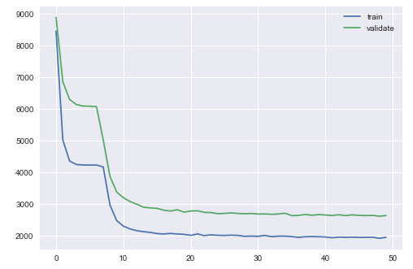
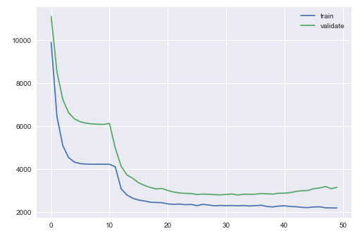
Training Model
Optimize with different hyper parameters

Slide 16
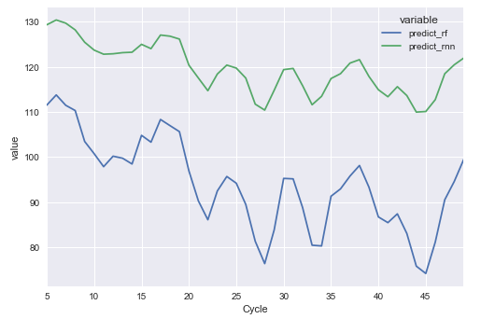
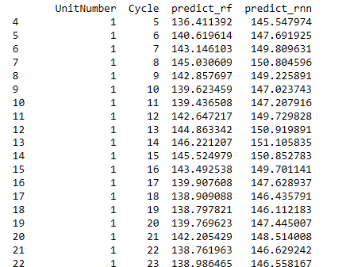
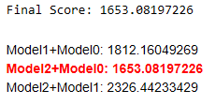
Ensemble Models
Finally to select “Random Forrest” and “Recurrent Neural Network” models, combine their predictions together and use KalmanFilter to get the final estimate

Slide 17
Case 2
Airplane Fuel Saving

Slide 18
Case2 Agenda
Purpose
Data Source Introduction
Fuel Cost/Time Analysis by Flight Phases
Analyze “Taxi” Phase
Analyze “Climb” Phase
Analyze “Cruise” Phase
Analyze “Approach” Phase
Other Considerations

Slide 19
Purpose
To Analyze FDR (Flight Data Recorder) data collected of multiple flights.
Try to find out the key parameters which affecting the Fuel Flow during different phase of a flight

Slide 20
Data Source
There was a data analysis competition hosted by Honeywell in 2016, data is provided by the Honeywell and public to download
https://www.crowdanalytix.com/contests/predict-fuel-flow-rate-of-airplanes-during-different-phases-of-a-flight
It includes 5 training data set archives and 1 testing data set archive.
Each Training Data archive includes 200 flights data (One csv each), it includes all the data of the entire flight lifecycle, separated by "PH" field as below:
0 = Unknown 4 = Climb
1 = Preflight 5 = Cruise
2 = Taxi 6 = Approach
3 = Takeoff 7 = Rollout

Slide 21
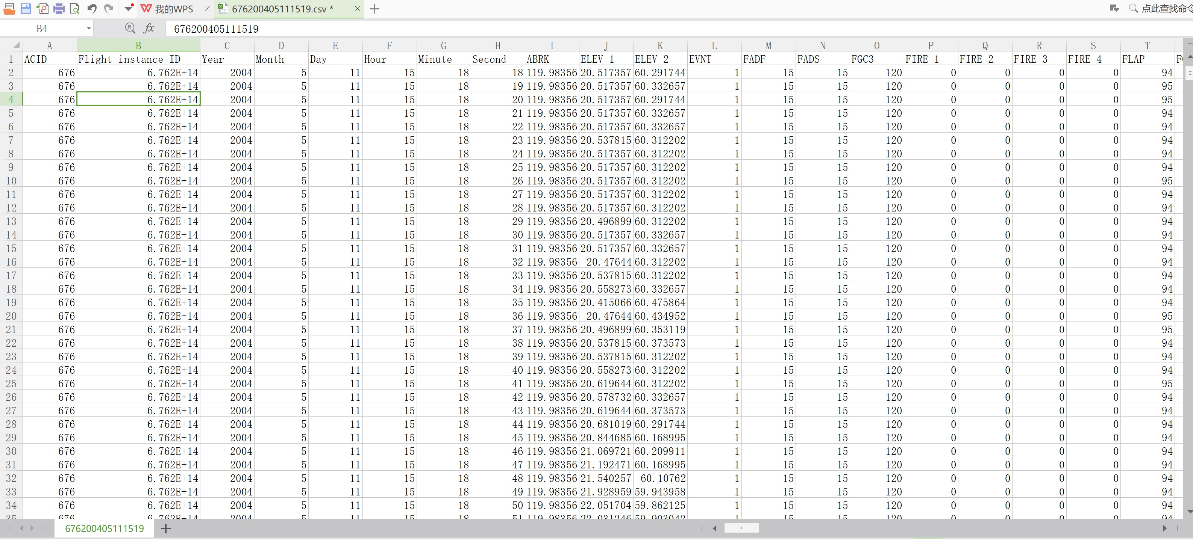
Data Source
One csv file includes the entire FDR data collected every second of a specific flight number. There are about 200 parameters recorded.

Slide 22
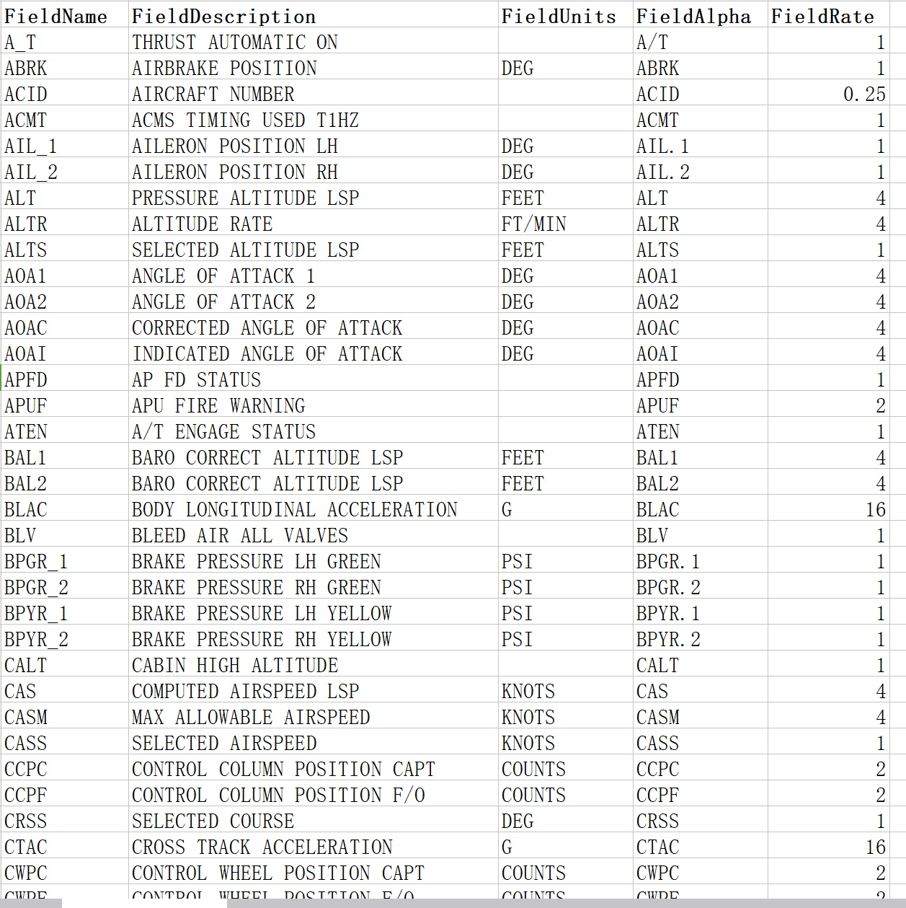
Data Source
Data Dictionary to introduce the 200+ parameters:

Slide 23
Data Source
There are more datasets from Nasa, anyone can download if interested in https://c3.nasa.gov/dashlink/projects/85/resources/?page=1&sort=-created&type=ds
Totally 35 datasets, each data is 800 MB zip file including about 700 flight data. Each flight is recorded in one "mat" file which is a matlab data file. We can use Matlab to load it and transfer it to csv for Python to load.

Slide 24
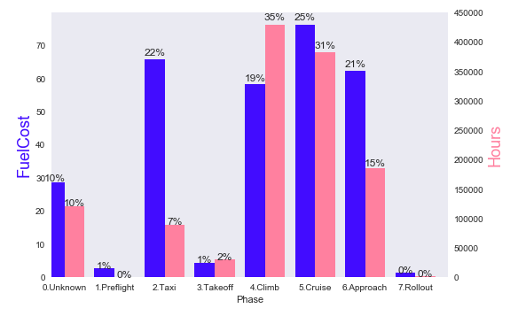
Fuel Cost/Time Analysis by Flight Phases
Phase | Fuel Cost | Hours
0.Unknown | 28.50 | 119488.38
1.Preflight | 2.55 | 94.00
2.Taxi | 65.61 | 88155.81
3.Takeoff | 4.26 | 29186.87
4.Climb | 58.10 | 428505.85
5.Cruise | 76.04 | 381555.93
6.Approach | 62.24 | 184788.06
7.Rollout | 1.19 | 1670.58
"2-Taxi" accounts for 7% fuel cost but has 22% time spent on this phase, we will analyze this phase in detail
"4-Climb" accounts for 35% fuel cost and 19% in time percentage, we will analyze this phase in detail
"5-Cruise" accounts for 31% fuel cost and 25% in time percentage, we will analyze this phase in detail

Slide 25
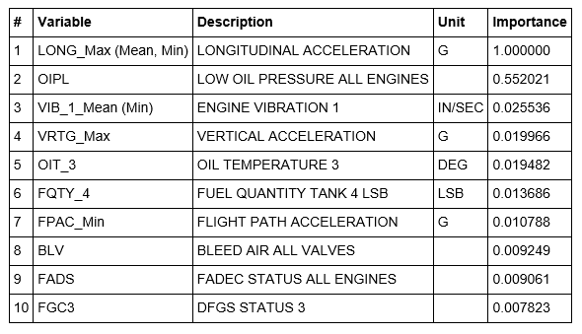
Analyze "Taxi" Phase
Use the “Gradient Boosting” Algorithm to find the top 10 key parameters affecting Fuel Cost during “Taxi” Phase
We may need “Domain Experts” to explain the backend rules.

Slide 26
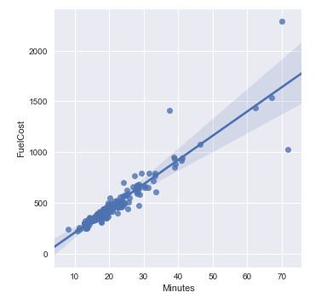
Analyze "Taxi" Phase
Is there anything else which may also affect the fuel cost during “Taxi” phase?
Let’s first of all check the relationship between Fuel Cost and “Taxi Time (In Minutes)”
It shows very clear "linear relationship" between Taxi Time (In minutes) and the Fuel Cost
Longer time spent on “Taxi” means more fuel cost.

Slide 27
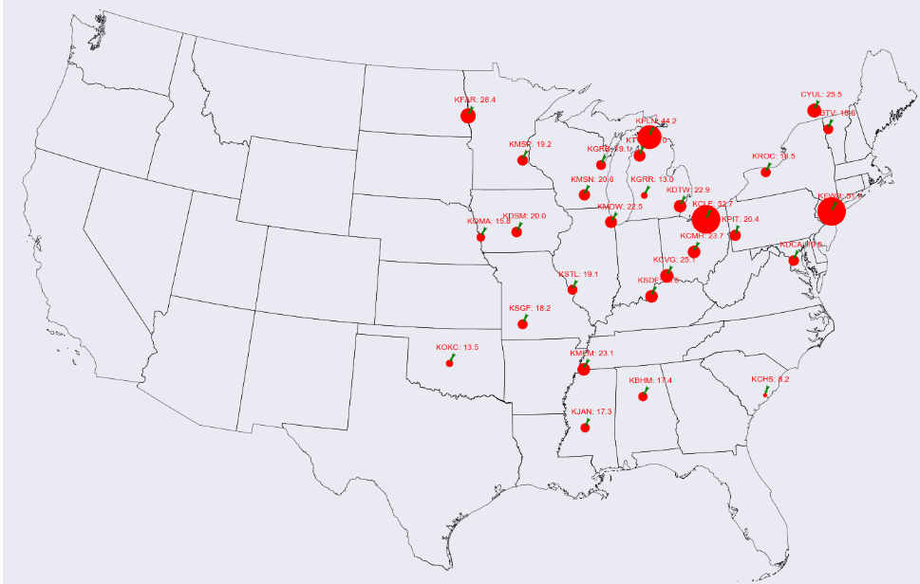
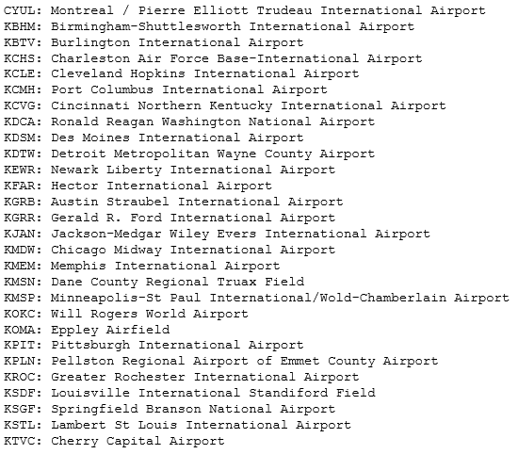
Analyze "Taxi" Phase
Most of the time, the “Taxi Time” is not controlled by pilot which is more affected by Airport. We will spot taxi data to Airports and analyze which Airport has the longest average Taxi time.

Slide 28
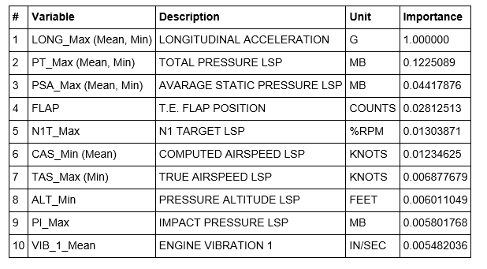
Analyze "Climb" Phase
Use the “Gradient Boosting” Algorithm to find the top 10 key parameters affecting Fuel Cost during “Climb” Phase
We may need “Domain Experts” to explain the backend rules.

Slide 29
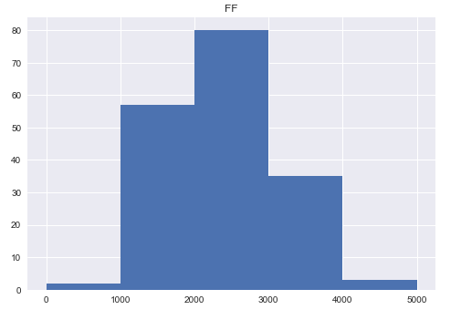
Analyze "Climb" Phase
First we will categorize the fuel cost into several groups
Low Fuel Cost 1000 ~ 2000
Med Fuel Cost 2000 ~ 3000
High Fuel Cost 3000 ~ 4000
Height of the bar tells how many flights’ fuel cost located within this range
We will ignore “<1000” and “>4000” 2 groups because they include very less flights #

Slide 30
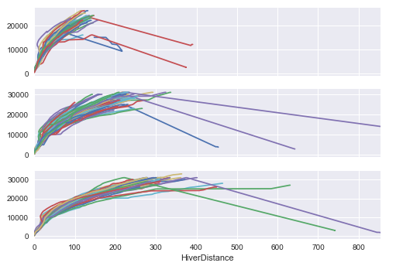
Analyze "Climb" Phase
Axis X - Hiver Distance (unit “km”) is a math calculation to get 2 points distance on surface of earth from the latitude and longitude location
Axis Y – The Climb height (unit “feet”) of the airplane
Low Fuel Cost 1000 ~ 2000
Med Fuel Cost 2000 ~ 3000
High Fuel Cost 3000 ~ 4000

Slide 31
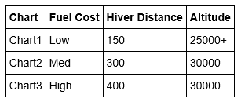
Analyze "Climb" Phase
The average hiver distance of chart1 (Low Fuel Cost 1000 ~ 2000) is 150 km, and their climb altitude is above 25000 feet
To use less time (also means less hiver distance) to climb to the standard altitude is the key of saving fuel cost during "Climb" phase.

Slide 32
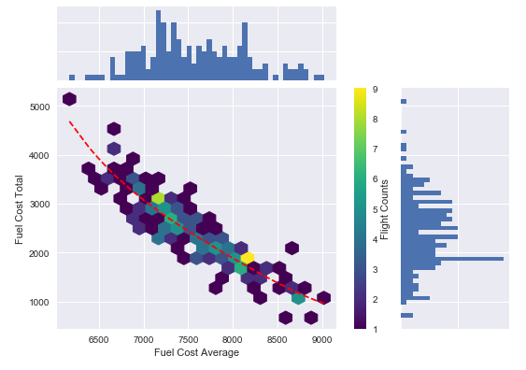
Analyze "Climb" Phase
Analyze Relationship Between Average Fuel Cost and Total Fuel Cost which will get same result as previous slide.
Low average fuel cost means High total fuel cost
High average fuel cost means Low total fuel cost
High average fuel cost means "Accelerate the airplane" as much as possible and climb to standard altitude as soon as possible
Not every flight can reach a good fuel efficiency, still a lot to improve
Most flights "average fuel cost" between 7000 and 8000, "total fuel cost" between 2000 and 3000e

Slide 33
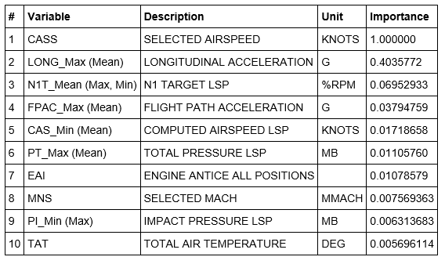
Analyze "Cruise" Phase
Use the “Gradient Boosting” Algorithm to find the top 10 key parameters affecting Fuel Cost during “Cruise” Phase
We may need “Domain Experts” to explain the backend rules.

Slide 34
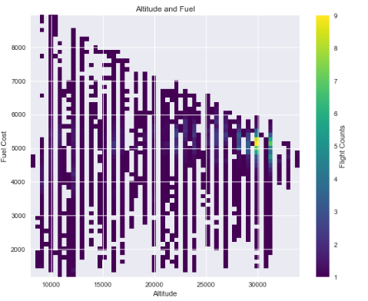
Analyze "Cruise" Phase
Cruise Altitude and Fuel Cost
Cruise Altitude is from 10000 feet to 30000 feet, Fuel Cost is from 2000 lbs/hr to 8000 lbs/hr. Basically Fuel Cost is decreasing along with the increasing of Cruise Altitude
Airplane may change altitude during the cruise phase, but looks like 30000 feet is a standard cruise height
If no other limited conditions, airplane should climb to 30000 feet and come into Cruise phase
In previous Climb phase, most flights will climb to 30000 feet height which is also reasonable Cruise phase

Slide 35
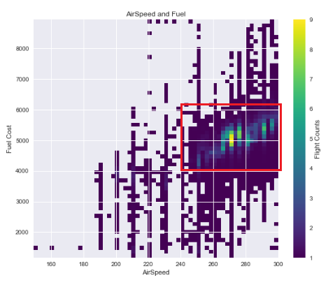
Analyze "Cruise" Phase
Cruise AirSpeed and Fuel Cost
Cruise AirSpeed is from 180 knots to 300 knots, Fuel Cost is from 2000 lbs/hr to 8000 lbs/hr. Basically Fuel Cost is increasing along with the increasing of Cruise AirSpeed
There is a hot area where AirSpeed is from 250 - 300 and Fuel Cost is from 4000 lbs/hr to 6000 lbs/hr. This should be a most efficient Cruise AirSpeed range.

Slide 36
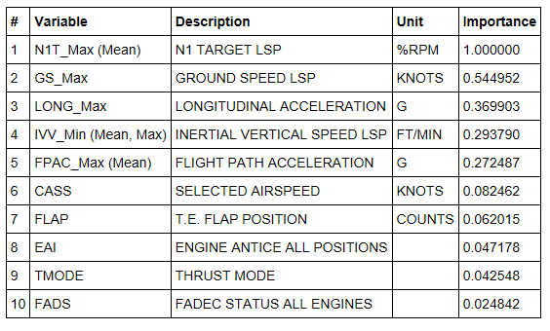
Analyze “Approach” Phase
Use the “Gradient Boosting” Algorithm to find the top 10 key parameters affecting Fuel Cost during “Approach” Phase
We may need “Domain Experts” to explain the backend rules.

Slide 37
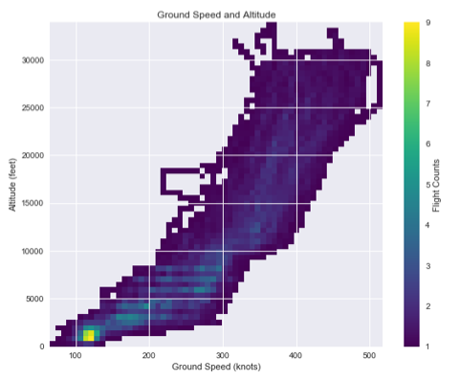
Analyze “Approach" Phase
Analyze the Ground Speed and Altitude
With the decreasing of Altitude, the Ground Speed is also decreasing slowly
There is a smaller range (Lighter Color) of Ground Speed at each Altitude which means most flights are within this range

Slide 38
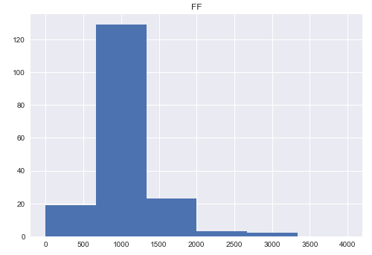
Analyze “Approach" Phase
First we will categorize the fuel cost into several groups
Low Fuel Cost 0 ~ 666
Med Fuel Cost 666 ~ 1332
High Fuel Cost 1332 ~ 1998
Height of the bar tells how many flights’ fuel cost located within this range
We will ignore “>1998” 2 groups because they include very less flights #

Slide 39
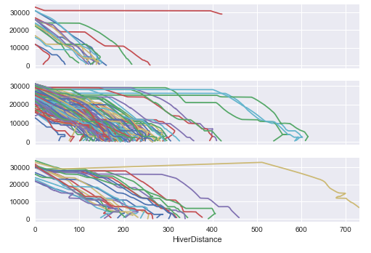
Analyze “Approach" Phase
Axis X - Hiver Distance (unit “km”) is a math calculation to get 2 points distance on surface of earth from the latitude and longitude location
Axis Y – The altitude (unit “feet”) of the airplane
Low Fuel Cost 0 ~ 666
Med Fuel Cost 666 ~ 1332
High Fuel Cost 1332 ~ 1998

Slide 40
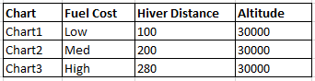
Analyze “Approach" Phase
The average hiver distance of chart1 (Low Fuel Cost 0 ~ 666) is 100 km, and descending from 30000 feet
To use less time (also means less hiver distance) to descend to the ground is the key of saving fuel cost during “Approach" phase.

Slide 41
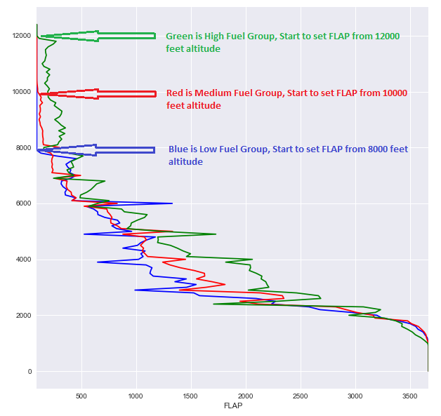
Analyze “Approach" Phase
Analyze the FLAP position and Altitude Relationship
To achieve saving fuel target, the airplane should start to set FLAP as late as possible which is called “Delayed-Flaps Approach”

Slide 42
Other Considerations
Cost Index
There is another key parameter named as "CI (Cost Index)" defined as CI = Time cost($/hr) / Fuel cost(cents/lb)
CI tells us that Fuel Cost is not the only key cost considered by Airline companies, sometimes the other time cost including but not limited to flight crew wages, leased airplane, engines or APU etc., maintenance cost.
The flight crew enters the airline company-calculated/suggested CI into the control display unit(CDU) of the flight management computer (FMC). The FMC then uses this number and other performance parameters to calculate economy (ECON) climb, cruise and descent speeds.
For all airplane models, entering zero for the CI results in maximum range airspeed and minimum trip fuel. This speed schedule ignores the cost of time. Conversely, if the maximum value for CI is entered, the FMC uses a minimum time speed schedule. This speed schedule calls for maximum flight envelope speeds, and ignores the cost of fuel.

Slide 43
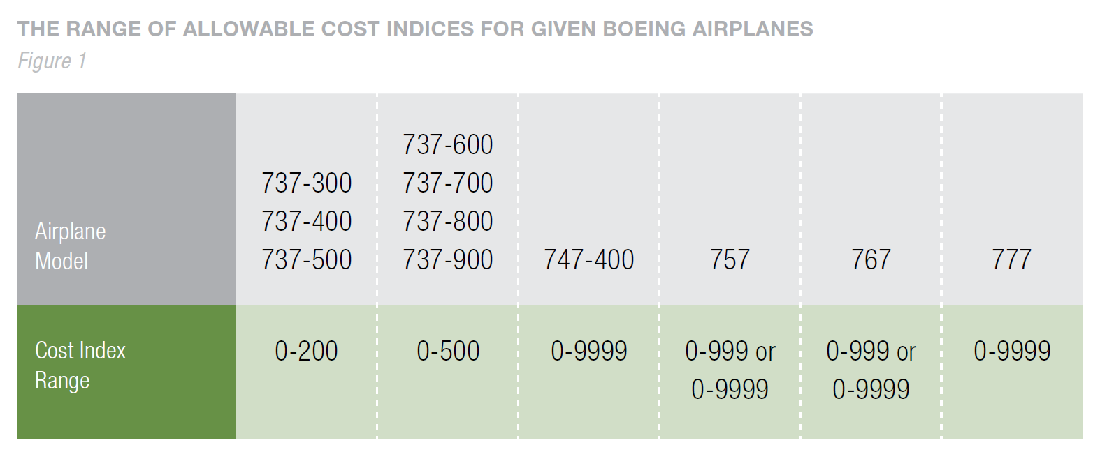
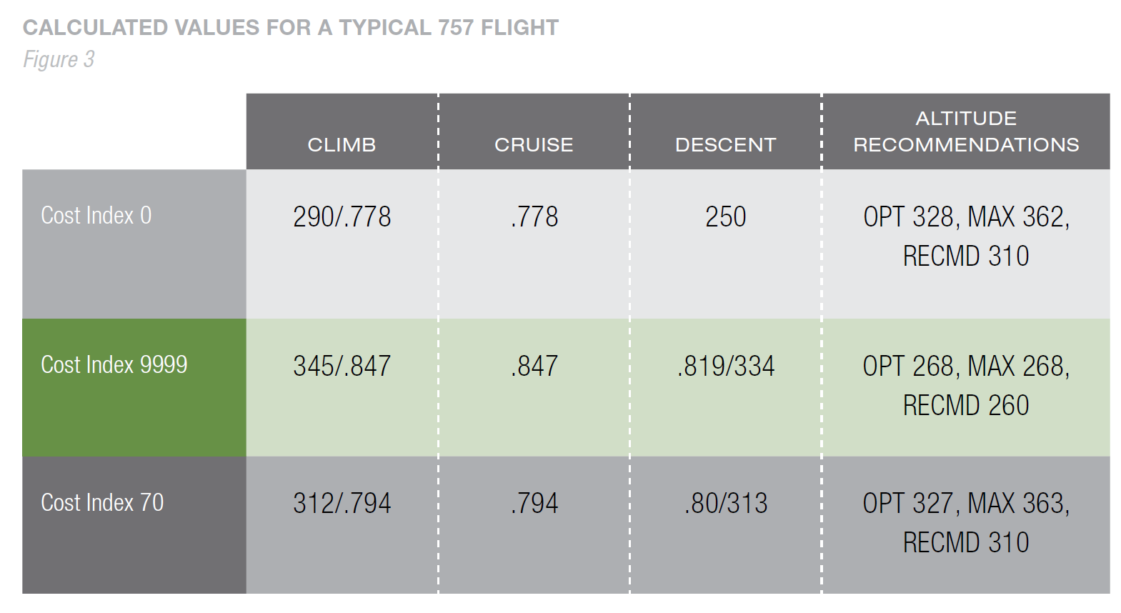
Other Considerations
Data come from Boeing “Fuel Conservation Strategies” whitepaper

Slide 44
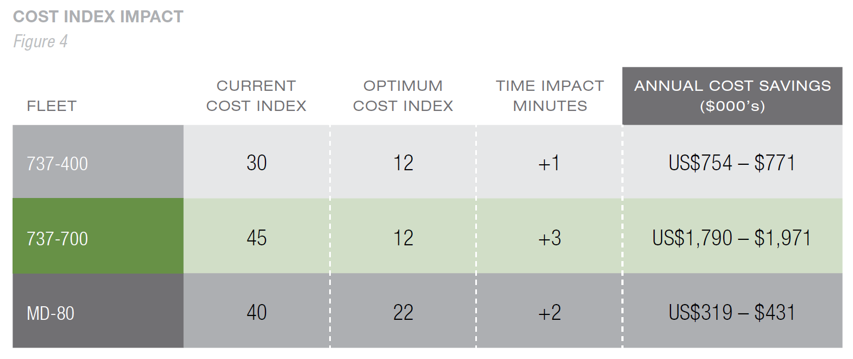
Other Considerations

Slide 45
Case 3
FDR Data Analysis on Tableau

Slide 46
Case3 Agenda
Purpose
Data Source Introduction
Flight Data Interactive Report

Slide 47
Purpose
To Analyze FDR (Flight Data Recorder) data collected of multiple flights.
Interactive Reporting to easily select Source-Destination Flights and analyze their performance on fuel cost

Slide 48
Data Source
Nasa Sample FDR Data Set; Totally 34 tail number and 160,000 # of flights
https://c3.nasa.gov/dashlink/projects/85/
About 180+ key parameters recorded at different frequency

Slide 49
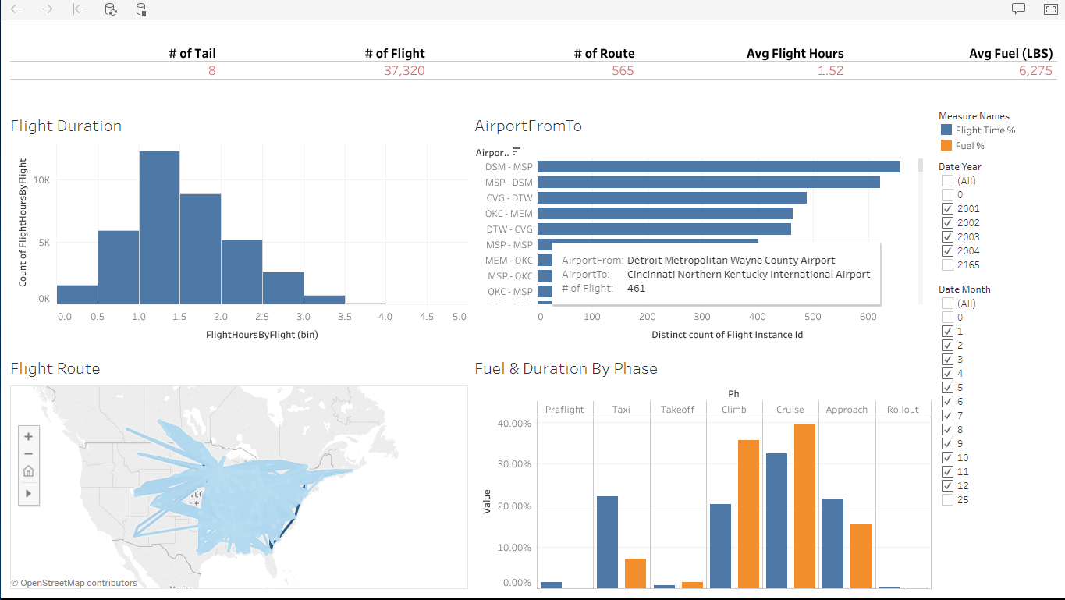
Flight Data Interactive Report
Select Airport FromTo, to compare the fuel/flight time difference on one route; Compare fuel performance for different route but similar total flight hours

Slide 50
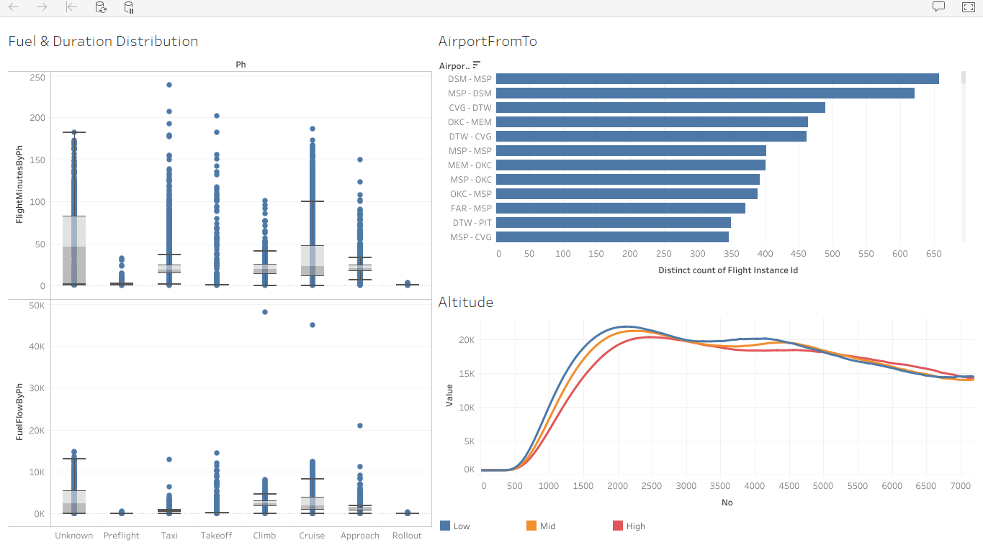
Flight Data Interactive Report
Flight Altitude Trend Comparison for different route and flight hours among high/medium/low fuel groups

Slide 51
Case 4
Engine Outlier Detection

Slide 52
Case4 Agenda
Purpose
Pre-processing
Feature Generation
Data Analysis

Slide 53
Purpose
Detect the Engine Outlier from FDR data.
Basic Process as below:
Pre-processing
Feature Generation
Data Analysis
Raw Dataset
(FDR tail653)
Correlation Analysis
Data Sampling
Cluster Algorithm
Aggregation
Data Selection
Result Analysis
Transformation

Slide 54
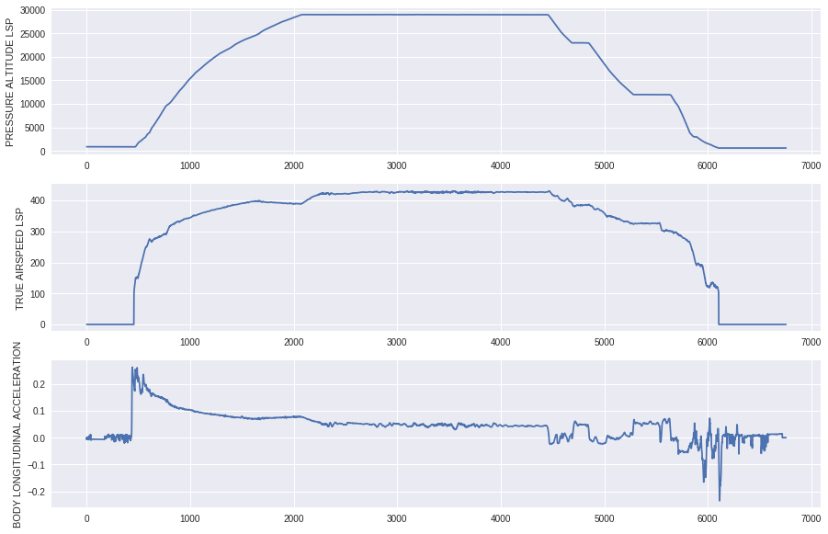
Data Sampling
Pick “TAS (True Airspeed)>0” as a start point
Pick 25 seconds range from start point, average value every 5 seconds, so totally 5 data points of each parameter

Slide 55
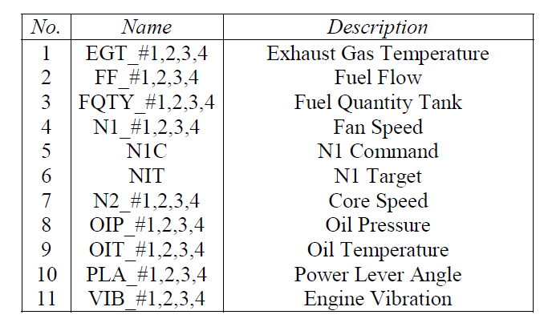
Data Selection
Below Parameters are selected related to Engine

Slide 56
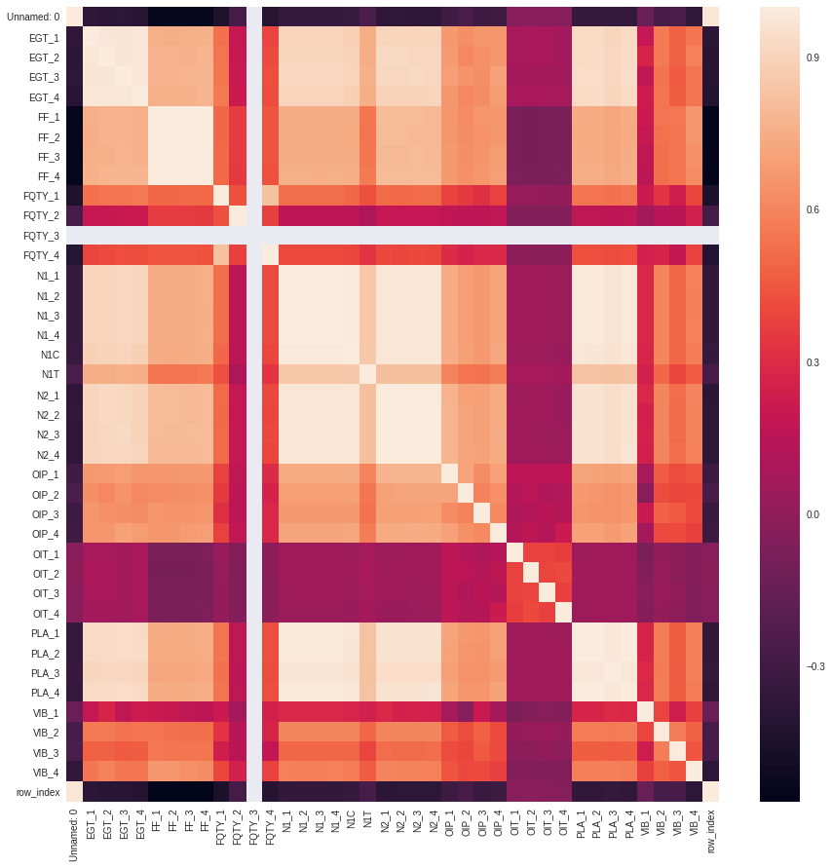
Correlation Analysis
Some parameters are highly correlated, merge them

Slide 57
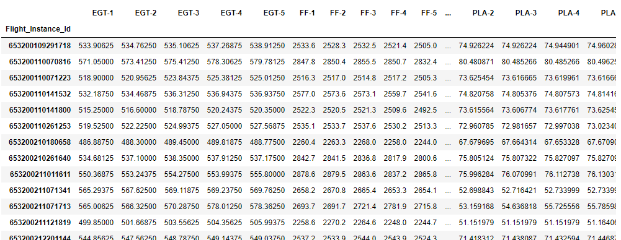
Aggregation & Transformation
Based on rule of data sampling, each parameter will be extended to 5 parameters (5 data points), so totally 55 parameters

Slide 58
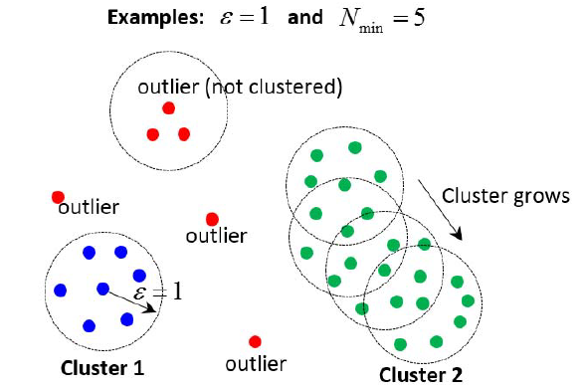
Cluster Algorithm
DBSCAN (density-based spatial clustering of applications with noise) Algorithm is used
Detection rate is affected by Hyper parameter “N” and “Epsilon”

Slide 59
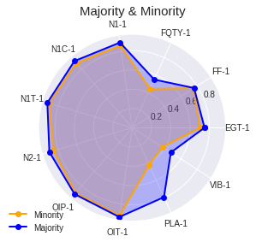
Result Analysis
DBSCAN (N=5 and Epsilon=6)
Group | # of flights
Majority | 3710
Minority | 10
Outlier | 15
No big different between “Majority” and “Minority” Groups, only small gaps on “FQTY” “PLA” and “VIB” parameters

Slide 60
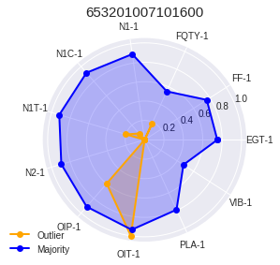














Result Analysis
Compare of 15 outliers with Majority Group

Slide 61
Appendix
Other Analysis Scenarios

Slide 62
Fuel Saving
Route based (long, medium, short) or pair based (point to point airport)
List some key fuel saving behaviors like Single Engine Taxi In/Out, APU usage, Reverse thrust etc.
Setup benchmark as compare target. Benchmark is based on experience value so it is not fully achieved.
Other considerations like Boeing Cost Index; ATR Airplane Fuel Saving Experience

Slide 63

Anomaly Detection - Basic
Exceedance Detection based on FAA rules
To define threshold is based on experience
Totally 61 monitoring events, more to add in the future

Slide 64
Anomaly Detect - Advanced
Machine Learning based methodology
Anomaly Detection of Aircraft Engine in FDR (Flight Data Recorder) Data; Feature generation, Dimension Reduction, Then Cluster
Failure detect and report through ACARS on old airplanes without CMC like 737 and 737 NG only with ACMS
FRiiDA An Integrated Flight Data Recorder Analysis Tool for Airbus; 2 cases: Flap Failure Signal and Landing Gear and Radio Height;
Autoencoder Neural Networks/Long Short Term Memory based Recurrent Neural/Networks and Gated Recurrent Units based Recurrent Neural Networks in detecting anomalies in aircraft performance data;
ClusterAD-Flight(DBSCAN) and ClusterAD-Data Sample(Gaussian Mixture Model); Expert Review; FLight Parameters Plots & Flight Abnormality Visualization

Slide 65
Prognostic
Multistage classification & on-demand regression approach; APU prognostics, demonstrates the usefulness of the developed methods.
Different methods for Data Pre-processing Algorithms, Feature Extraction Algorithms, Health Assessment and Anomaly Detection Algorithms, Health Diagnostic Algorithms, Prognostics Algorithms; Case Study in Wind Turbine Monitoring System
Problems can be classified into 3 categories, health assessment, fault classification and remaining useful life prediction. common issues and unique challenges have been clearly pointed out for each problem and each category. analyze all solutions regarding what type of strategy a particular solution took, what algorithms it used and how it overcame the challenges

Slide 66
Thanks & Questions

